Slide 1
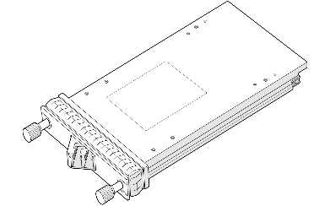
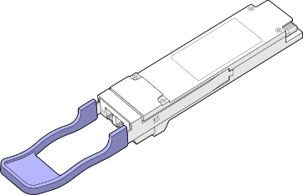
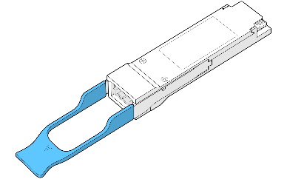
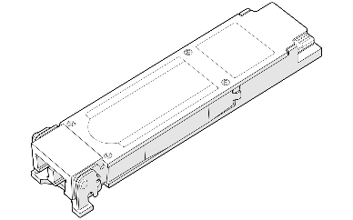
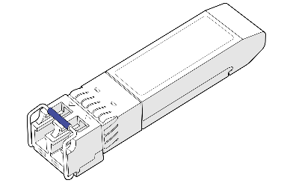

CFP2/CFP
400G/200G
100G
40G
25G/10G/1G
SHENZHEN 6COM TECHNOLOGY CO., LTD
04-1-2021

Slide 2
CONTENTS
01
02
03
04
Company
R&D
Production
Sales
COMPANY
R&D
PRODUCTION
SALE

Slide 3

6COM INTRODUCTION
6COM was founded at Shenzhen, June 14th, 2011 which had also estabilished new branch in Wuhan.
6COM is occupied up to 1000 squares modern workshop and office in Baoneng Science Park,Longhua, Shenzhen. and New Brand-QSFPTEK is located in Wuhan base owned 2000squares center,forming a 5G communications high-tech enterprise integrating R&D, production and sales system.

Slide 4

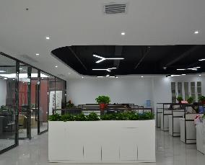
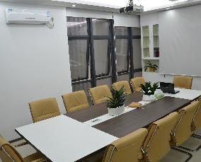

OFFICE AREA
Front Desk
Marketing Office
Meeting Room
Reception Hall

Slide 5
6COM DEVELOPMENT
200/400G AOC， 100G Coherent 5G SFPs and OMUX series products
Company was founded in June 14, 2011, committed to R&D and production of 10G or lower datarate SFPs
Realize the mass production and global mass supply of 40G series optical modules.
2011-2014
2015
2016
2017
2018
2019-2020
New production line was putted into use, small batches trial production of 100G CFP products.
100G QSFP28 and QSFP28-DD Public
Devoting to 5Gnext generation data center connecting market at our wuhan 2000 squares base in 2020

Slide 6

R&D

Slide 7
R&D TEAM
The R&D team has been deeply involved in the optical communication industry for many years and has extensive experience in the fields of optics, precision machinery, electronics, software, and optoelectronic integration.

Slide 8
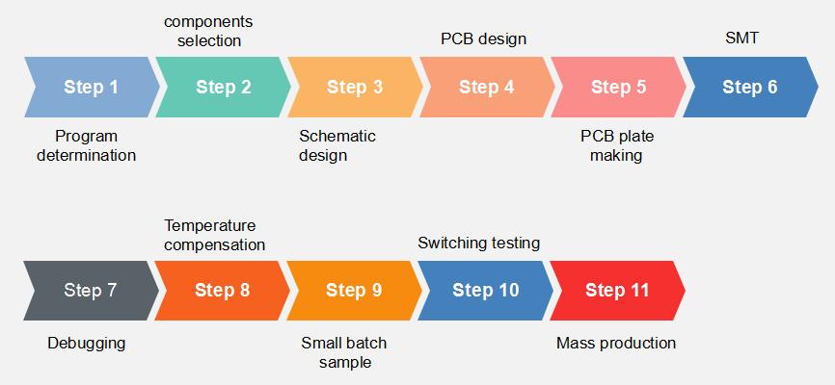
R&D SCHEDULES

Slide 9

DATA CENTER
10G/25G/40G/100G/400G/800G Series Optical Module

Slide 10

TRANSMITION NETWORK
6COM products comply with SFP+ MSA, XFP MSA, QSFP+, CFP series standards which can be applied to enterprise networks, transmition networks, Ethernet, data storage SAN,SONET/SDH and many other fields. Using mature and high-efficient lasers and mainstream driver chip solutions in optics industry with low power consumption and high reliability, the range covers from 155M to 100G market application requirements.

Slide 11

WIRELESS NETWORK
5G front haul, middle haul, back haul

Slide 12
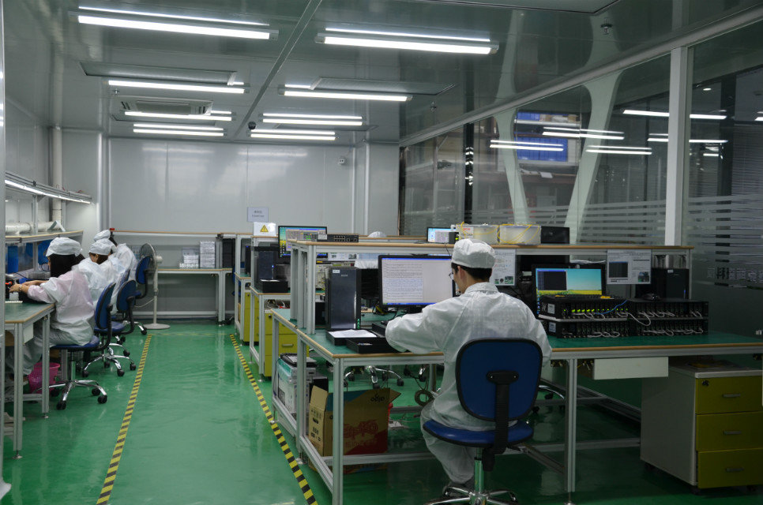
WORKSHOP

Slide 13
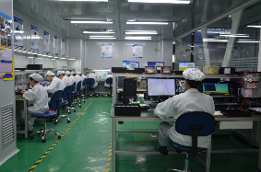

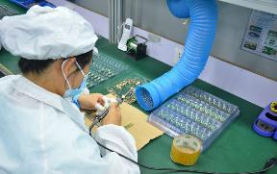
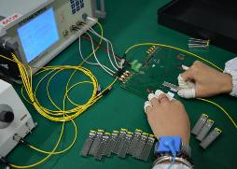
WORKSHOP SCHEDULE
6COM Devoting to whole communication solution provider.
6COM specialises in the development of optical communication products including R&D, manufacturing, sales and services. We are committed to providing our customers with cost-effective optoelectronic communication products and simple, efficient and reliable solutions for fibre optic storage and data communication networks; as well as customizing (OEM/ODM) advanced active and passive optoelectronic communication products to meet customers' needs. Our products are fully compliant with industry standards and protocols such as ETHERNET Ethernet, Fibre Channel FC, INFINI-BAND, SONET/SDH/OTN, CPRI and PON. They can be widely used in telecom, broadcasting, data centres, base stations, transmission networks, data networks, access networks, FTTX, SDH/SONET, CATV/CD-MA/WLAN, cloud storage, etc.

Slide 14
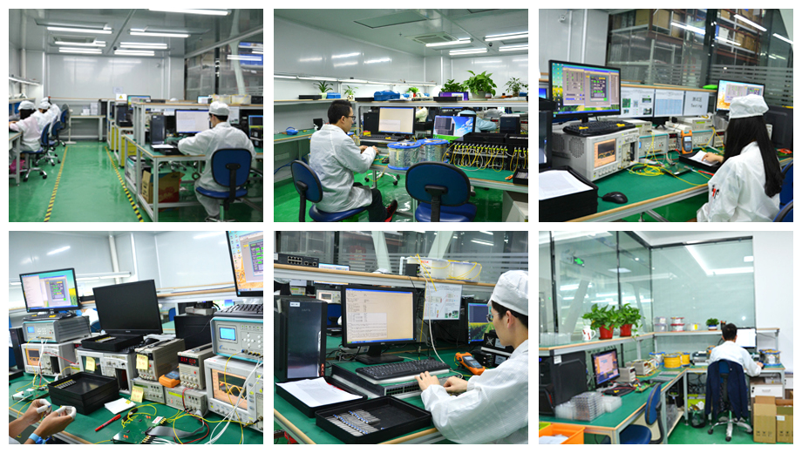
WORKSHOP PHOTOS

Slide 15

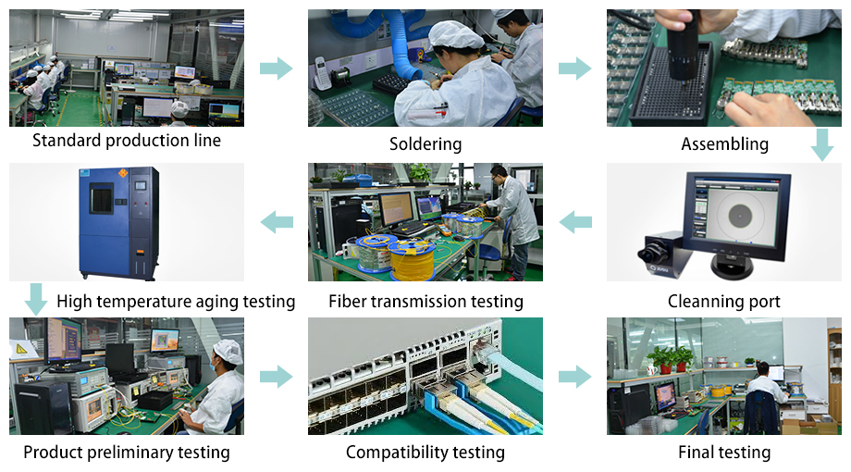
PRODUCTION SCHEDULES

Slide 16
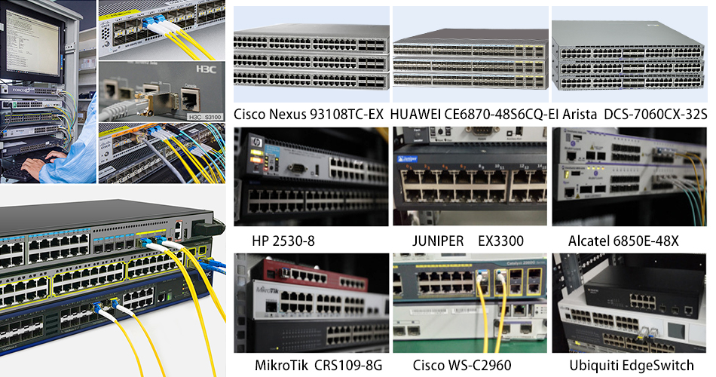
TESTING ON SWITCHES

Slide 17

COMPATIBLE BRANDS

Slide 18
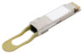
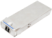


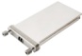


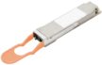
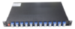

MAIN PRODUCTION LINE
Optical Module
AOC Cable
Coherent Module
400G QSFP-DD
200G QSFP-DD
100G QSFP28
100G CFP2
25G SFP28
10G SFP+
10G XFP
400G QSFP-DD AOC
200G QSFP56 AOC
100G QSFP28 AOC
120G CXP AOC
40G QSFP+ AOC
25G SFP28 AOC
10G SFP+ AOC
200G CFP2 DCO
100G CFP DCO
Passive Device
OMUX
DWDM
CWDM
AAWG

Slide 19














BRAND COOPERATION
Core partner
Related products series | 200G/400G | 200G/400G | 100G QSFP28/ CFP/CFP4/Video | 10G\100G QSFP28 | 10G\25G\100G
Core Materials | Coherent chip | Silicon Photonics chip | 100G TOSA/ROSA, CDR, TIA, Driver | CDR, Driver, TIA | TO\TOSA\ ROSA
Core partner
Related products series | 1.25G-10G/40G/100G | 1.25G-10G,100G | 2.5G\10G\25G\100G | 25G/40G/100G/ 200G/400G | 1.25G-10G/40G
Core Materials | VCSEL/PD | VCSEL/PD/ PHY chip | TO-TOSA\ROSA | Driver/TIA/CDR/DSP/Gearbox | Driver/TIA/TEC
Core partner
Related products series | 10G/25G/40G/100G xWDM | AWG, PLC | AWG | AWG, PLC | PLC, xWDM
Core Materials | VCSEL/PD/ Filter for xWDM | AWG, PLC chip | AWG chip | AWG, PLC chip | G-Lens

Slide 20
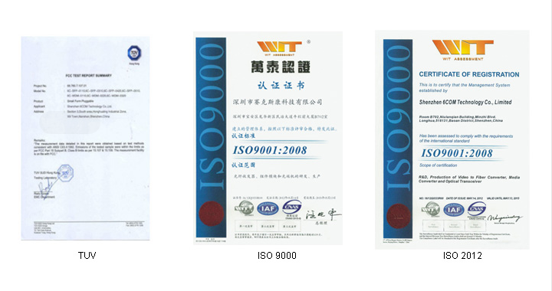

TUV ISO 9001: 2012 2015

Slide 21
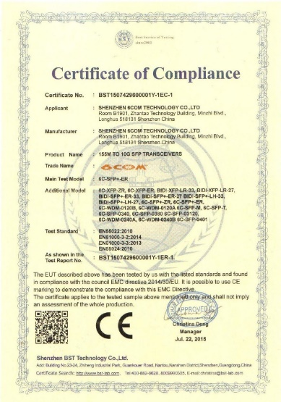
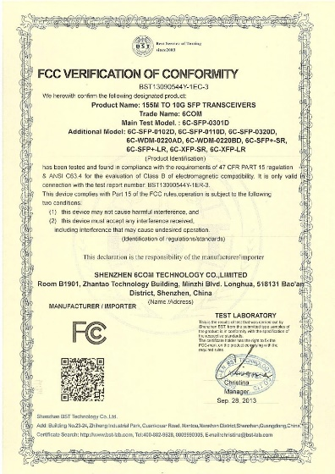
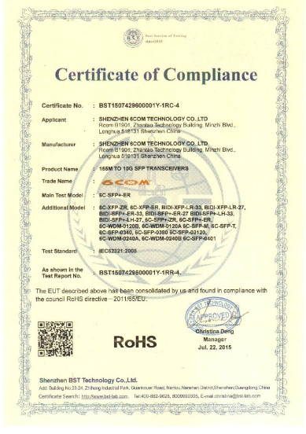
CE FCC ROHS CETIFICATES

Slide 22

MARKETING & SALES

Slide 23

10G SERIES HOTSALES
Sumitomo, CY... component are used, stock more than 3000pcs
DWDM SFP+ | DWDM-SFP+-ER-XX | DWDM SFP+ 1530.33nm 40KM | DWDM-SFP+-ER | OEM | 10G | CH17~61 | EML+PIN
 | DWDM-SFP+-ZR-XX | DWDM SFP+ 1530.33nm 80KM | DWDM-SFP+-ZR | OEM | 10G | CH17~61 | EML+APD
 | DWDM-SFP+-ZR-Tu | DWDM SFP+ Tunable 80KM | DWDM-SFP+-ZR | OEM | 10G | CH17~61 | EML+APD

Slide 24
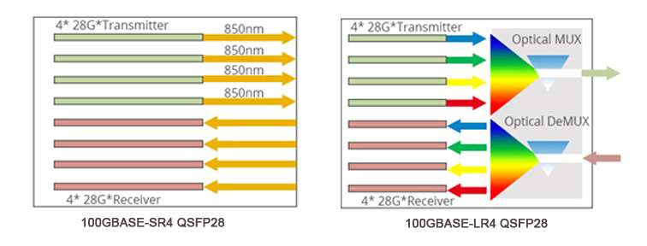
25G/100G SERIES
Sumitomo, CY... component are used, stock more than 1000pcs
25G | SFP28 | 6C-SFP28-SR | SFP28 25G 850nm 100M | SFP28-SR | OEM | 25G | 850 | VSEL
 |  | 6C-SFP28-LR | SFP28 25G 1310nm 10KM | SFP28-LR | OEM | 25G | 1310 | DFB/PIN
100G | QSFP28 | 6C-QSFP28-SR4 | QSFP28 100G 850nm 100M | QSFP28-SR4 | OEM | 100G | 850 | VCSEL/PIN
 |  | 6C-QSFP28-LR4 | QSFP28 1295-1310nm 10KM | QSFP28-LR4 | OEM | 100G | LWDM 1294-1310 | DFB/PIN

Slide 25
ORDER PROCESSING PROCEDURE
START
Inquiry from Customer
Quotation
Confirm PO details
Issue PI
Customer inquiry some items from us
Providing complete solution and quotation based on customer demand
Confirm order details (compatibility, label and other requests)
Issue PI and send for customer confirmation
Cleanning
QC
Production
ERP Order
Cleanning SFPs
Eye diagram test, high and low temperature aging test, fiber transmission test, coding writing and competibility test, etc.
Production line arrange production according to ERP information and feedback LT
Once order confirmed, inputting order information into ERP system
Picture as record
Packing
Shipment
Inform customer
END
Taking picture for each type SFP and attach in testing report as record
Packing products
Preparing relevant documents and arrange shipment
Sharing tracking number, product pictures, packing list, testing report etc for customers

Slide 26


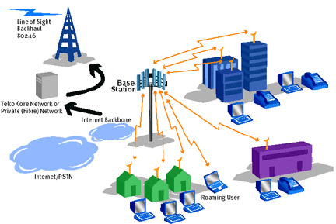
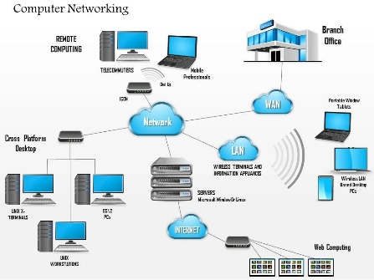
MARKETING AREA
Telecom Operators
Devices Provider
Transmition Network
Enterprises

Slide 27
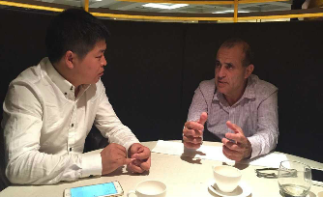
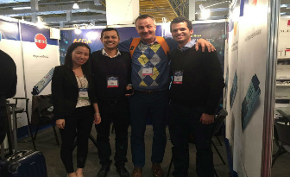
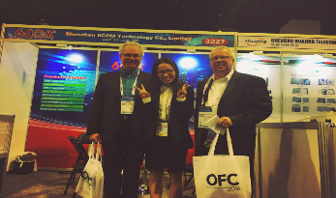
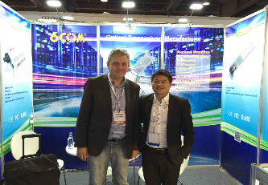
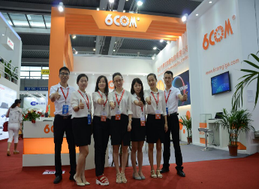
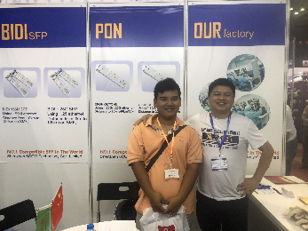
EXHIBITION
Singapore(CommunicAsia 2015)
Brazil(NETCOM 2015)
USA(OFC2015-2016)
Spain(ECOC 2015)
Shenzhen (CIOE 2016)
Vietnam(ICTCOMM 2018)

Slide 28


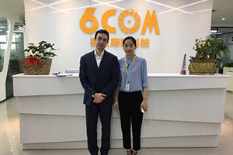

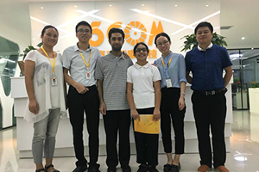
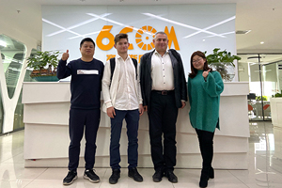
CUSTOMER VISIT

Slide 29












PARTNERSHIP

Slide 30

MAIN MARKETS
8%
13%
8%
3%
15%
18%
10%
8%
3%
6%
8%

Slide 31

6COM ADVANTAGES
10Years Experience
Widely compatibility
Quality Guarantee
Up to 10years experience of SFPs manufactuering
Factory has ISO 9001 certificate, products passed CE FCC RoHS etc.
large stock
customized service
First Class Services
Professional OEM/ODM
Fast response, High production & Prompt Delivery
Advantage
Large scale OEM/ODM service are provided for several big companies in the world
technic support
quality guarantee
R&D Team
Perfect Compatible Services
25G/50G/100G/ 200G/400G high datarate R&D base is located in both Shenzhen and Wuhan
fast shipment
Widely compatible most of switches, routers, internet firewall, MC, server, line care...

Slide 32

Thank You!
http://www.6comgiga.com

